Slide 1

THE NEUTRAL ENVIRONMENT PART 2

Slide 2


EXAMPLE
1) Estimate the erosion depth of a Kapton panel on the spacecraft in the previous example oriented in the ram direction during low, medium, and high solar activity. The atomic-oxygen number densities are$6 x {10}^{6}, 2 x {10}^{7}, and 1 x\frac{{10}^{8 }atoms}{,}$, respectively.
If the Kapton panel has a thickness of 100 µm, would the satellite deorbit or would its panel erode first?
How could you make your estimate more accurate?

Slide 3
QUIZ #1
Which of the follow orbits would be affected the most by earth’s atmospheric drag:
A communications satellite (24 hour period)
b. GPS satellite (12 hour period)
c. ISS (90 minute period)
d. Geo graveyard orbit (300 km above Geo)
e. Artemis (moon mission)

Slide 4

QUIZ #2
Which object would have the largest Coefficient of drag?
a.
b.
c.
d.
e.
$$\overset{⃑}{V}$$

Slide 5
QUIZ #3
Which object would have the largest Ballistic Coefficient?
a.
b.
c.
d.
e.
$$\overset{⃑}{V}$$

Slide 6
QUIZ #4
Which of the follow is true about drag’s effect on an orbit’s total energy, potential energy, and kinetic energy?
ε increases, PE increases, KE decreases
ε increases, PE decreases, KE increases
ε decreases, PE increases, KE decreases
ε decreases, PE decreases, KE increases
All remain constant

Slide 7
QUIZ #5
Which of the COEs are affect by drag and how? (select all that apply)
Semi-major axis increases
Semi-major axis decreases
Eccentricity increases
Eccentricity decreases
Inclination increases

Slide 8
quiz #6
IN WHICH ATMOSPHERIC LAYER IS THE EARTH’S OZONE?
TROPOSPHERE
STRATOSPHERE
MESOSPHERE
THERMOSPHERE
EXOSPHERE

Slide 9
quiz #7
Which of the earth’s atmospheric layers is nearly isothermal?
TROPOSPHERE
STRATOSPHERE
MESOSPHERE
THERMOSPHERE
EXOSPHERE

Slide 10
quiz #8
In this class, we consider space to begin at the karman line
a. True
b. false

Slide 11
quiz #9
Atomic oxygen is relatively stable above the stratosphere; i.e. does not vary much with the sun’s solar cycle
a. True
b. false

Slide 12
quiz #10
Which of the earth’s atmospheric layers is the coldest?
TROPOSPHERE
STRATOSPHERE
MESOSPHERE
THERMOSPHERE
EXOSPHERE

Slide 14
DALTON’S LAW OF PARTIAL PRESSURES

Slide 15
AVOGADRO’S LAW

Slide 16
EXAMPLE 1
Given a sample gas as a pressure of 6.34 atm consisting of 1.39 total moles of which 0.50 mole is nitrogen. Determine the partial pressure of nitrogen.

Slide 17
EXAMPLE 2
Determine the molar mass of the atmosphere of the Earth at sea level, given that the fractional components by volume are oxygen ~ 21%, nitrogen ~ 78.1% and argon ~ 0.9%

Slide 18
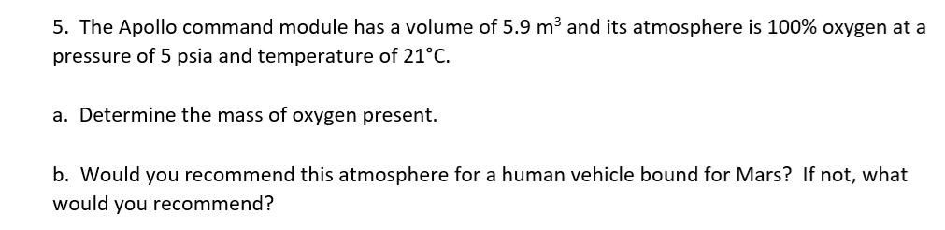
HOMEWORK 3 PROBLEM 5

Slide 19
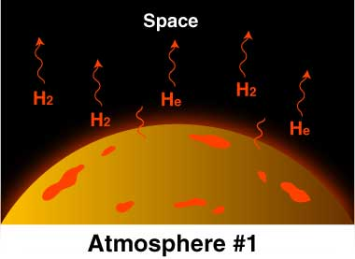
EARTH’S ATMOSPHERE

Slide 20
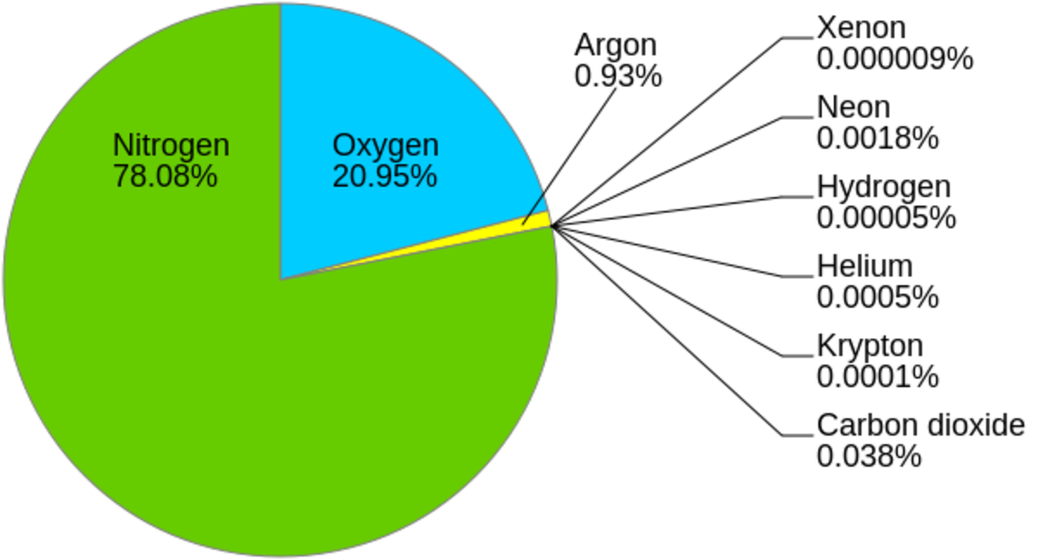
EARTH’S ATMOSPHERE

Slide 21
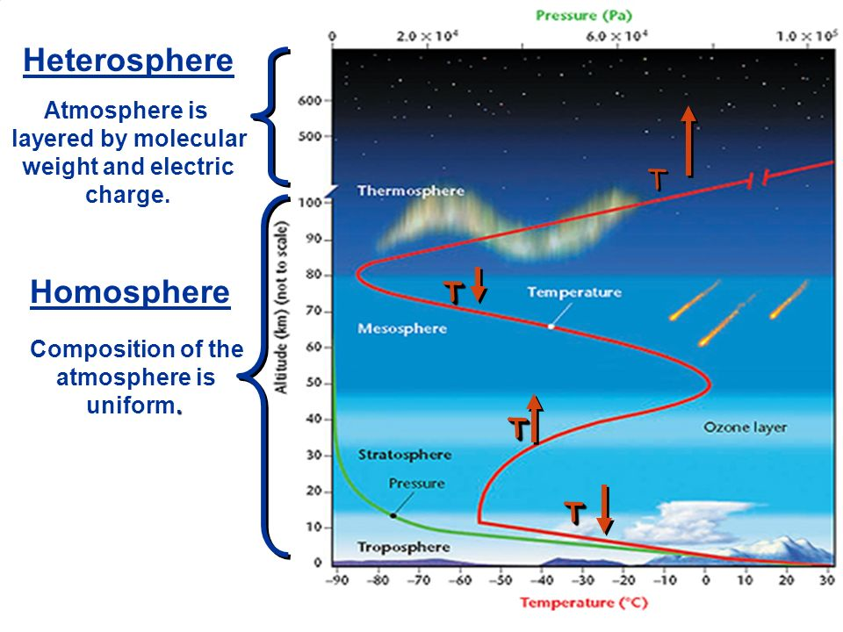
EARTH’S ATMOSPHERE
IONOSPHERE

Slide 22
CONSITUENTS OF HETEROSPHERE

Slide 23
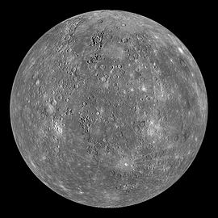
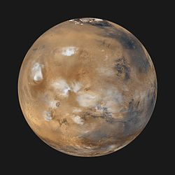
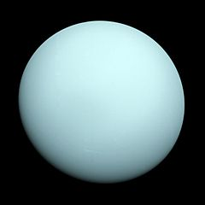

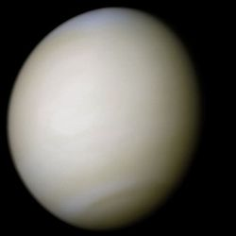
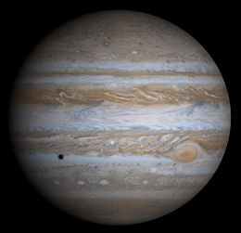
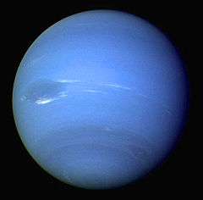
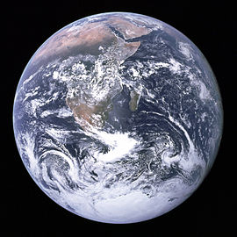
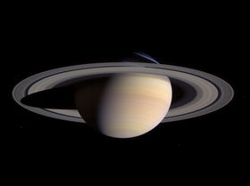


Planets
☿
♀

Slide 24
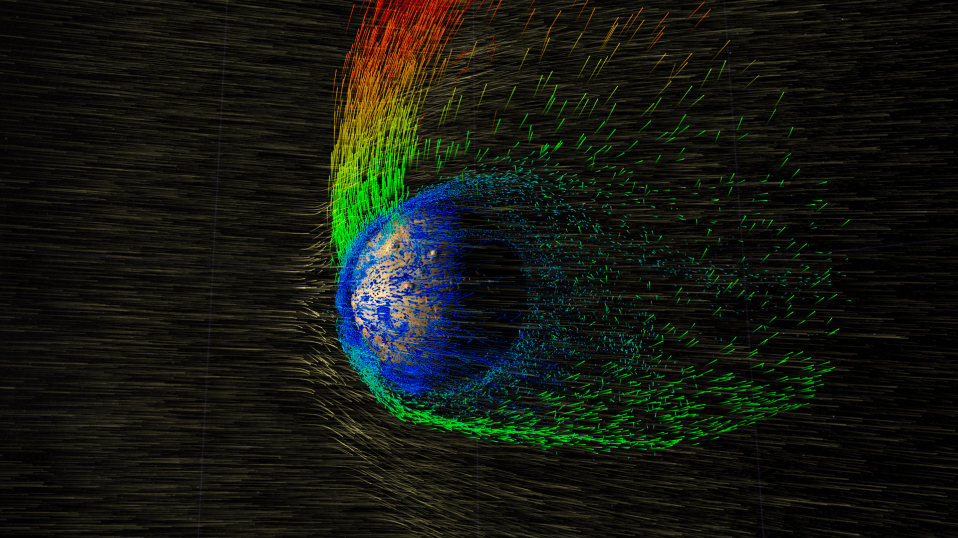
5 MAIN MEANS OF LOSS OF PLANETARY ATMOSPHERE
Thermal escape
Bombardment
Atmospheric cratering
Condensation
Chemical reaction

Slide 25
PLANETARY ATMOSPHERIC LOSS
THERMAL ESCAPE
Lower mass and higher temperature particles can overcome gravitational attraction of the planet

Slide 26
PLANETARY ATMOSPHERIC LOSS
BOMBARDMENT
Impact by extraplanetary particles can increase the atmospheric thermal velocities and break up heavier molecules into lighter atoms and molecules so they can escape

Slide 27
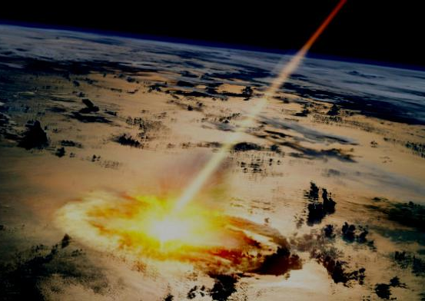
PLANETARY ATMOSPHERIC LOSS
ATMOSPHERIC CRATERING
Large impacts on the surface impart sufficient energy to allow constituents to escape

Slide 28
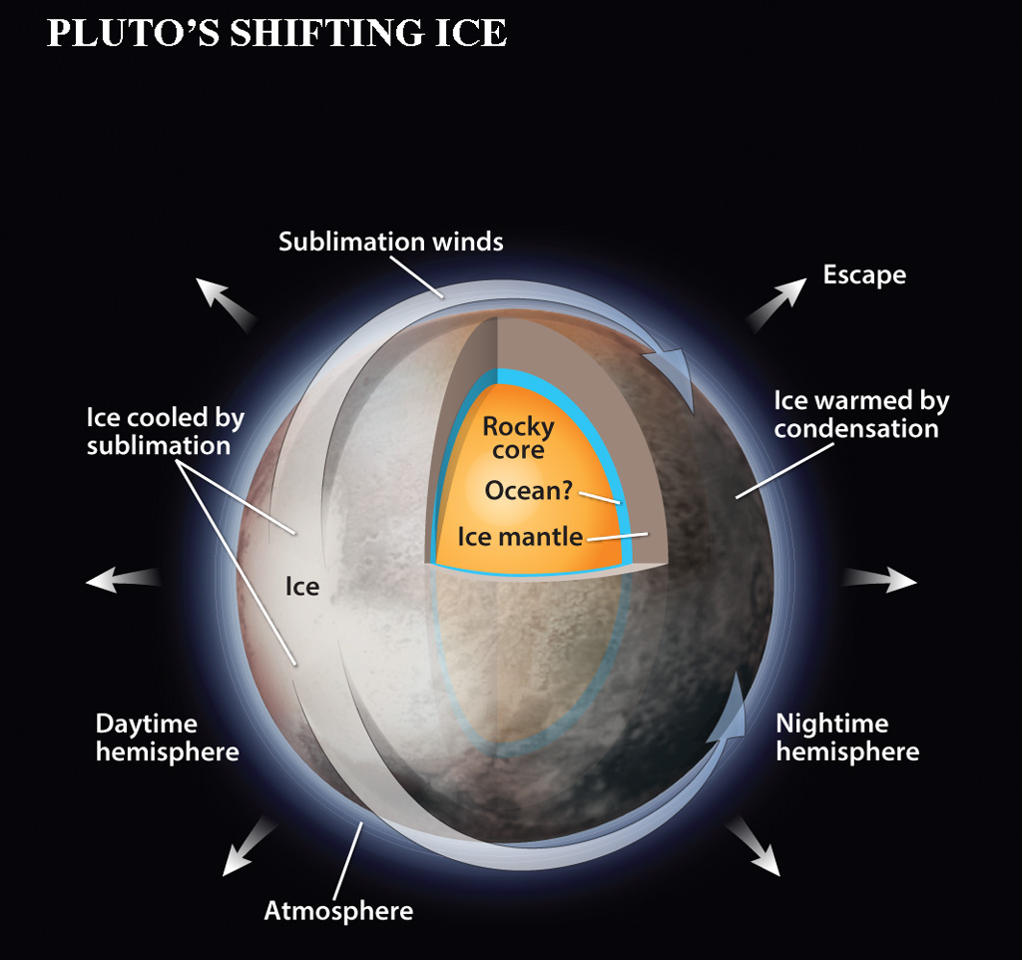
PLANETARY ATMOSPHERIC LOSS
CONDENSATION
Atmospheric constituents condense on the planet’s surface

Slide 29
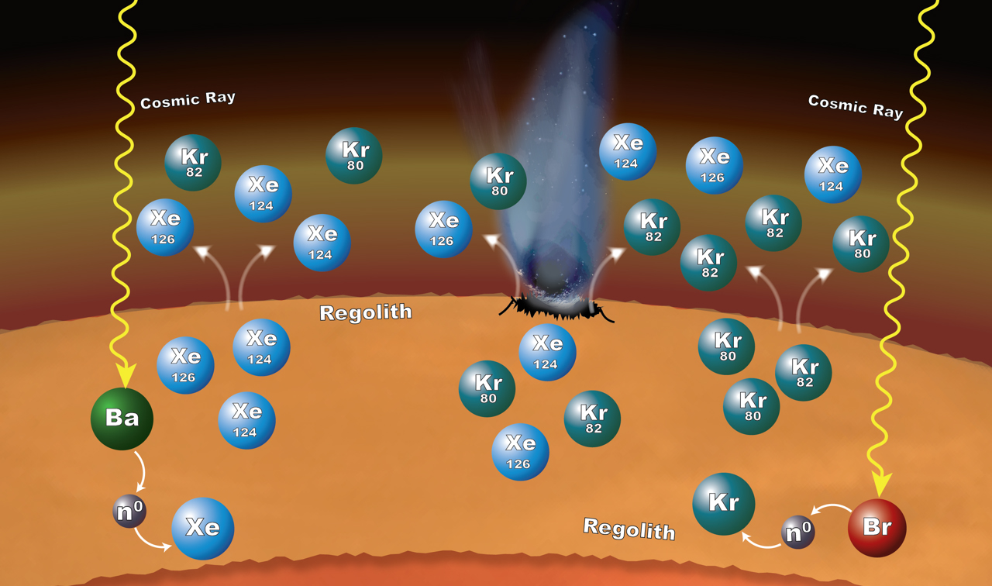
PLANETARY ATMOSPHERIC LOSS
CHEMICAL REACTION
Atmosphere combines with the material on the planetary surface

Slide 30
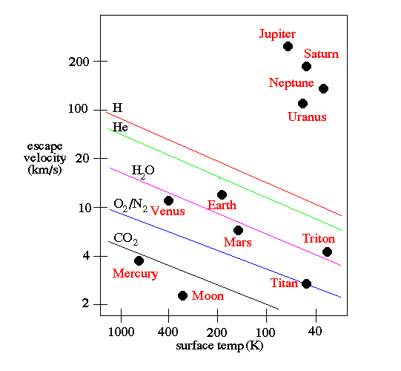
ESCAPE VELOCITIES FOR CONSISTUENTS

Slide 31
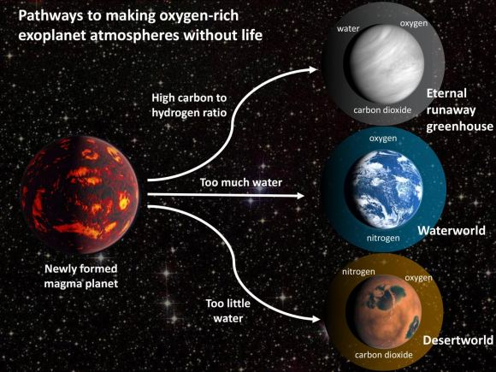
HOW PLANETS GAIN ATMOSPHERIC GASES
OUTGASSING
EVAPORATION AND SUBLIMINATION
BOMBARDMENT

Slide 32

OUTGASSING
Volcanoes expel water, carbon dioxide, molecular nitrogen, hydrogen sulfide and sulfur dioxide

Slide 33
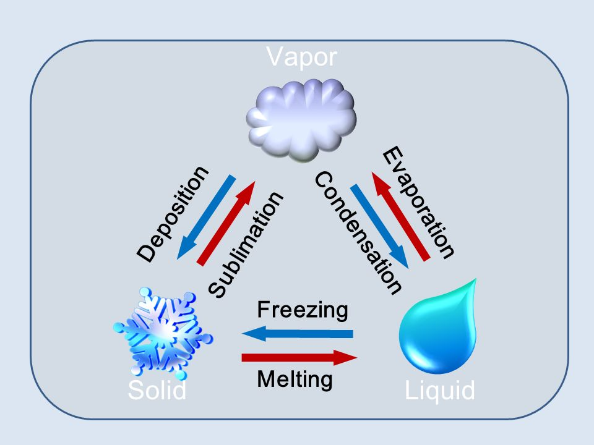
EVAPORATION AND SUBLIMINATION
Surface material are released into the atmosphere

Slide 34
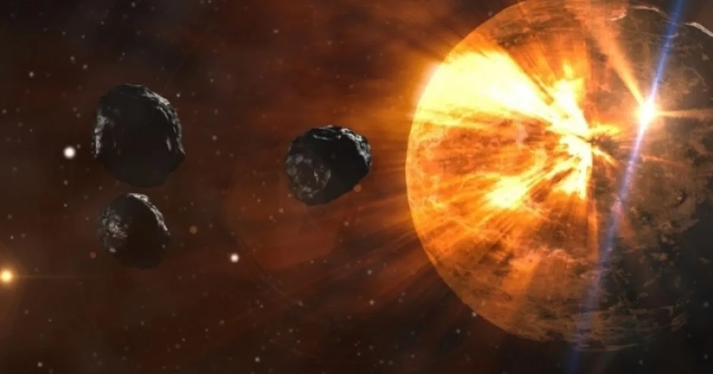
BOMBARDMENT
Surface materials are vaporized by comets and asteroids

Slide 35
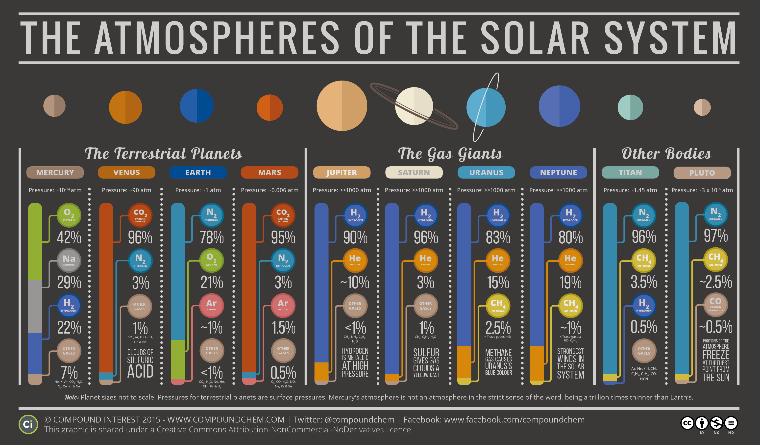

Slide 36
PLANETARY ATMSOPHERIC PARAMETERS

Slide 37
ATOMIC OXYGEN

Slide 38
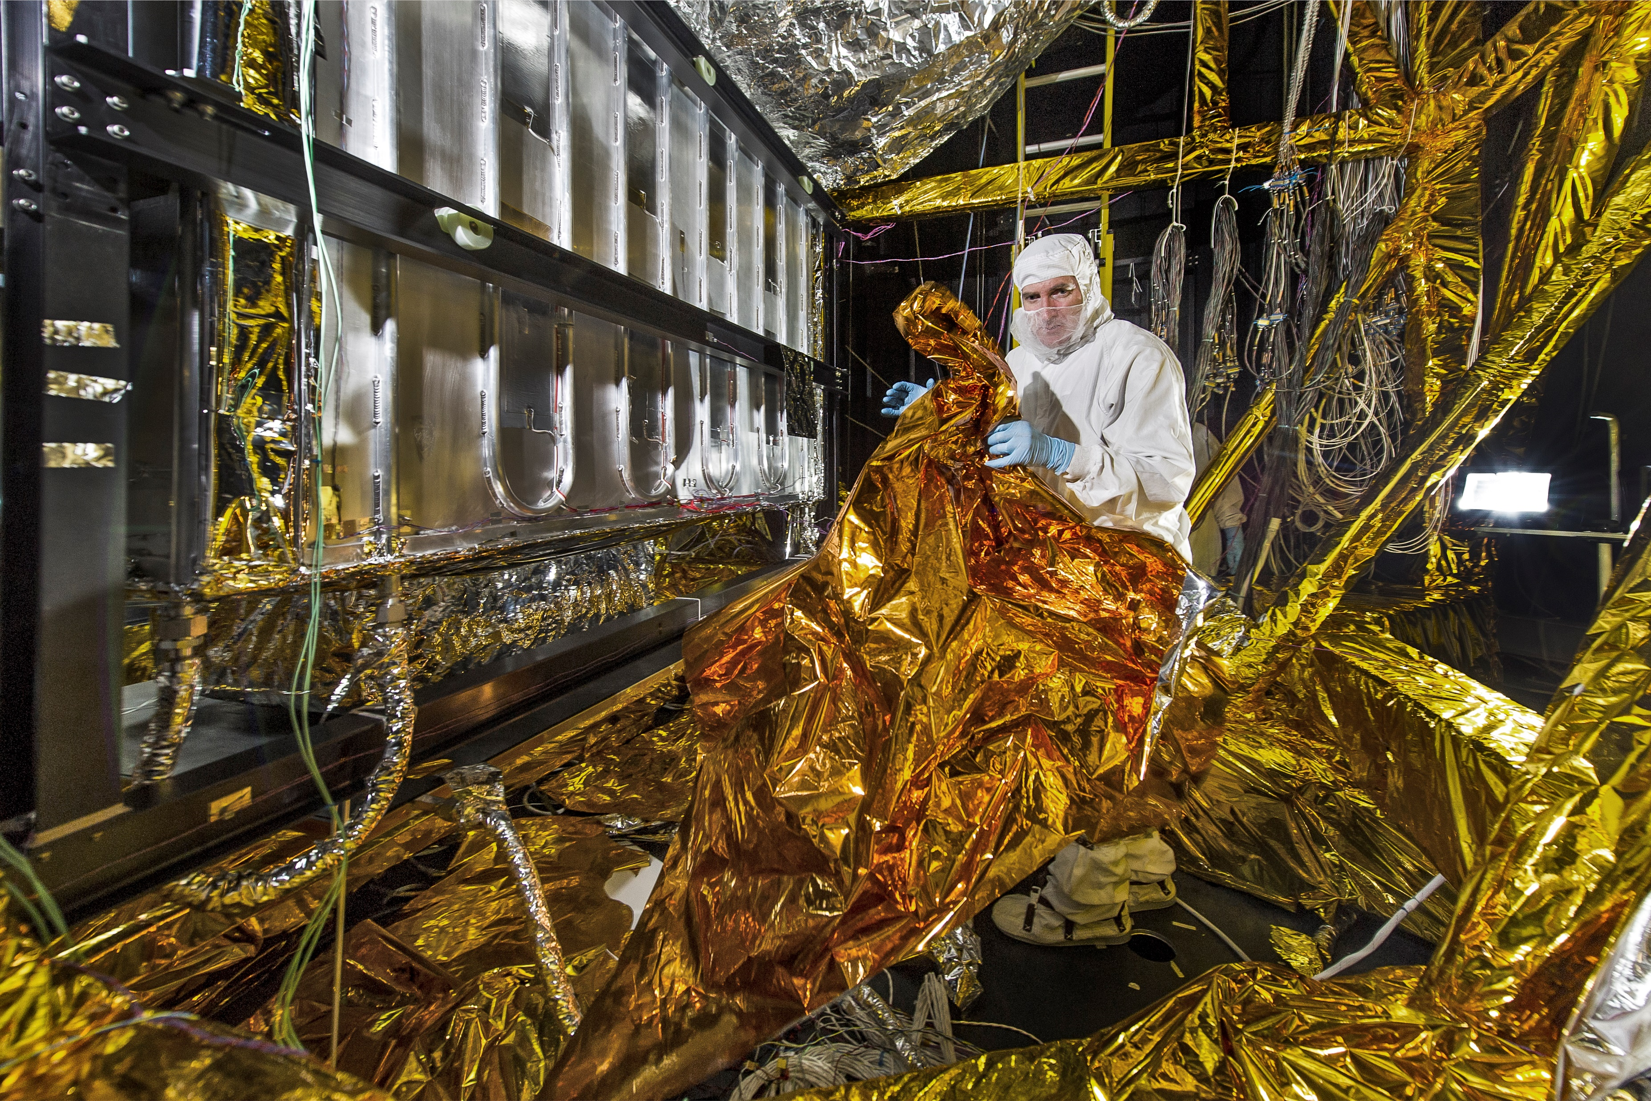
Atmospheric Neutral Environment
Atomic Oxygen Attack:
Atomic oxygen is the predominant atmospheric constituent from 200 km to 600 km and reacts chemically with surface materials
Leads to solar array degradation, thermal property changes, and structural weakening
Mass loss is:
reaction efficiency
material density
atomic oxygen flux
Notes:
Energy of impact breaks bonds
“sand blasting” or ablation effect
In the absence of surface charging (which energizes surface particles and makes it easier to knock them off)
Again, tends to be a concern only for long-term missions
Erosion due to oxidation
(remote sensing missions)
Although atmospheric density drops by 10 orders of magnitude at an altitude of 300 km, there are still 10¹⁷ particles per m³ to interact with the spacecraft both mechanically and chemically
Optical emissions near exterior surfaces (size or relative geometry may be an important factor -- small satellites vs shuttle)
A related phenomenon which may be of concern for optically sensitive experiments is spacecraft glow. Optical emissions are generated from metastable molecules which have been excited by impact on the surface of the spacecraft. Investigations show that the surface acts as a catalyst, thus the intensity is dependent on the type of surface material.

Slide 39
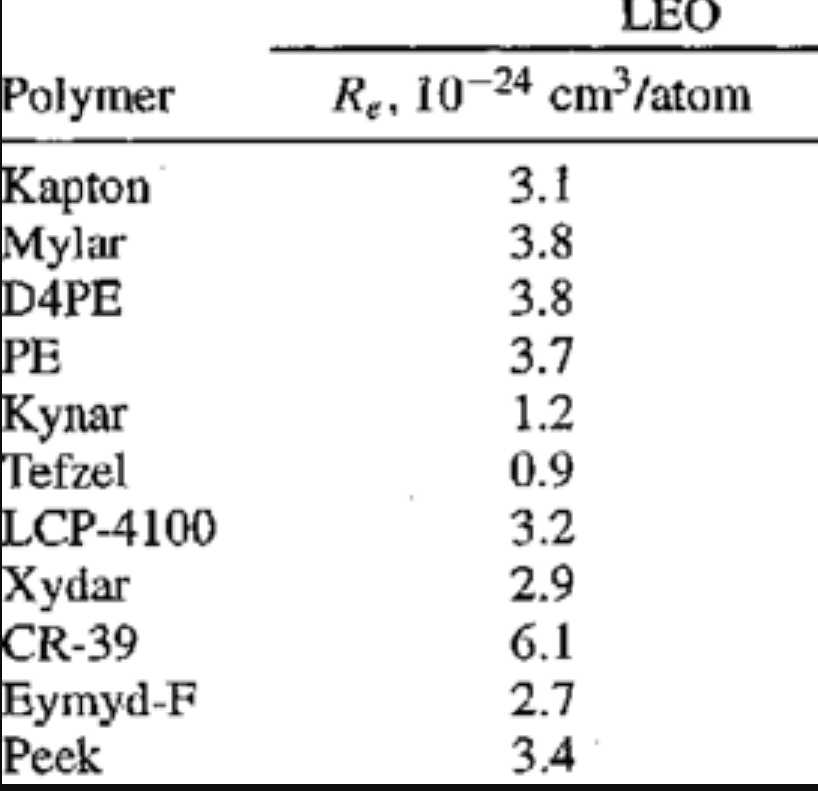

Rate of change of thickness of material
$$dx=REфdt$$

Slide 40
EXAMPLE
If the Kapton panel has a thickness of 50 µm would the satellite deorbit first (with no orbital corrections) or would its panel erode first?

Slide 41
HOMEWORK 3 PROBLEM 4
4. Determine the erosion depth per year of a Kapton panel of a spacecraft oriented in the RAM direction (the side that points in the direction of the satellite’s velocity vector) at an altitude of 450 km during low, medium, and high solar activity. The atomic-oxygen number densities are 6 x 10⁶, 2 x 10⁷, and 1 x 10⁸ atoms/cm³, respectively.

Slide 42
QUANTIFYING THE EFFECTS
Ground testing
Estimate atomic oxygen fluence in space as a function of altitude, worst case solar activity and geographic location
Carry out statistical analysis to determine the degradations
Compare with other similar materials
Add material as needed to survive expected effects

Slide 43
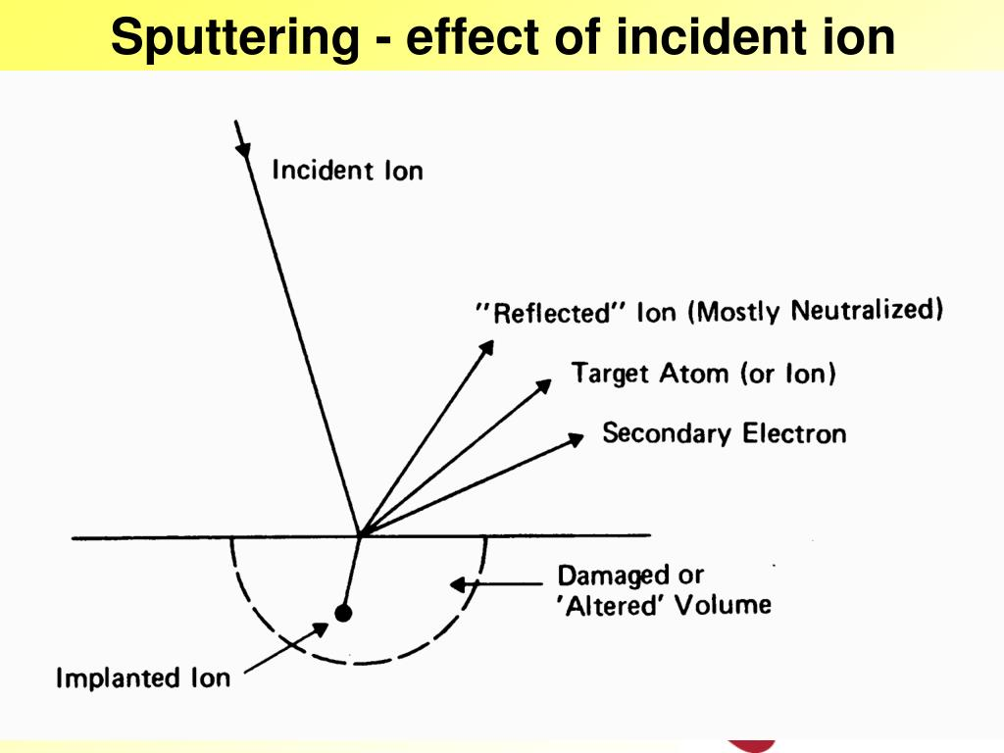
Atmospheric Neutral Environment
Physical Sputtering:
Neutral molecule collisions with spacecraft surface
Effect can be greatly increased with spacecraft charging
Usually only significant factor for long duration missions (>30 years)
Notes:
Energy of impact breaks bonds
“sand blasting” or ablation effect
In the absence of surface charging (which energizes surface particles and makes it easier to knock them off)
Again, tends to be a concern only for long-term missions
Erosion due to oxidation
(remote sensing missions)
Although atmospheric density drops by 10 orders of magnitude at an altitude of 300 km, there are still 10¹⁷ particles per m³ to interact with the spacecraft both mechanically and chemically
Optical emissions near exterior surfaces (size or relative geometry may be an important factor -- small satellites vs shuttle)
A related phenomenon which may be of concern for optically sensitive experiments is spacecraft glow. Optical emissions are generated from metastable molecules which have been excited by impact on the surface of the spacecraft. Investigations show that the surface acts as a catalyst, thus the intensity is dependent on the type of surface material.

Slide 44
SPUTTERING YIELDS AT 100 EV IMPACT ENERGY

Slide 45
Atmospheric Neutral Environment – Spacecraft Glow
Not well understood, but is a function of altitude and reaction with neutral environment
Can have mission-limiting impact on optical sensors
Brightness is function of altitude:
brightness
altitude
(B measured in Rayleighs; H measured in km)
Notes:
Energy of impact breaks bonds
“sand blasting” or ablation effect
In the absence of surface charging (which energizes surface particles and makes it easier to knock them off)
Again, tends to be a concern only for long-term missions
Erosion due to oxidation
(remote sensing missions)
Although atmospheric density drops by 10 orders of magnitude at an altitude of 300 km, there are still 10¹⁷ particles per m³ to interact with the spacecraft both mechanically and chemically
Optical emissions near exterior surfaces (size or relative geometry may be an important factor -- small satellites vs shuttle)
A related phenomenon which may be of concern for optically sensitive experiments is spacecraft glow. Optical emissions are generated from metastable molecules which have been excited by impact on the surface of the spacecraft. Investigations show that the surface acts as a catalyst, thus the intensity is dependent on the type of surface material.

Slide 46
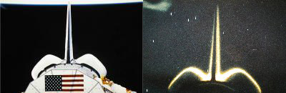
SPACECRAFT GLOW

Slide 47
Quantifying Neutral Environment Effects
Sputtering
Verify that materials used are not susceptible to sputtering at impact energies seen on orbit.
Atomic Oxygen Erosion
Determine cumulative atomic oxygen flux to surfaces.
Relate atomic oxygen flux to material erosion based on reaction efficiency values.
Spacecraft Glow
Estimate glow intensity based on orbit altitude.
Add to noise terms and determine effect, if any, on sensors.
Aerodynamic Drag:
Identify acceleration due to drag from atmospheric density, orbit velocity, and vehicle configuration
Drag coefficients typically range between 2 and 4 (average is 3.1); ballistic coefficients typically range between 25 and 200 kg/m² (average is 109)
Use results to estimate the mass of fuel required to counter drag (will be a function of the propulsion system I_{sp})
Notes:
Solely an energy transfer calculation
Models for mass loss do exist
Another signal to noise ratio study
Must replace the energy losses
empirical

Slide 48
REFERENCES
A new timeline of Earth's cataclysmic past. CU Boulder Today. (2019, August 12). Retrieved June 29, 2022, from https://www.colorado.edu/today/2019/08/12/new-timeline-earths-cataclysmic-past
Astronomers once thought Pluto's atmosphere would condense down to the Surface. (2016, March 28). Astronomy.com. Retrieved June 29, 2022, from https://astronomy.com/magazine/ask-astro/2016/03/plutos-falling-sky
Atmospheric Chemistry. (2018, October 24). The atmospheres of the solar system. Retrieved June 29, 2022, from http://www.compoundchem.com/2014/07/25/planetatmospheres/
NASA. (2016, September 29). Isotopic clues to Mars' crust-atmosphere interactions – NASA mars exploration. NASA. Retrieved June 29, 2022, from https://mars.nasa.gov/resources/8055/isotopic-clues-to-mars-crust-atmosphere-interactions/
Pisacane, V. L. (2016). The space environment and its effects on Space Systems. Amazon. Retrieved June 29, 2022, from https://www.amazon.com/Space-Environment-Effects-Systems-Education/dp/1563479265

